Slide 1



ANNUAL REPORT
HEALTH AND SOCIAL CARE PILOT
Healthcare team
ME Association

Slide 2


Contents
  Introduction
  Overview
  AIMS
  Key findings
  Services/ Involvement of others
  Annual Highlights
  Actions and Impact
  SNOMED
  Education
  Social Care
  Working Group
  Working time analytics
  Sustainability and funding
  Challenges
  Feedback reviews
  Next steps

Slide 3



INTRODUCTION
This report presents the findings of the 2025 Health and Social Care pilot project conducted by the Healthcare Team.
The primary objective of the project was to evaluate the services available for Myalgic Encephalomyelitis/Chronic Fatigue Syndrome (ME/CFS) and Long Covid.
The aim is to demonstrate how these findings can inform policy changes, thereby influencing strategies to enhance service provision and understanding.
The area we selected for the pilot was extensive, encompassing just under two million people.
We have engaged meaningfully with stakeholders, including healthcare professionals, the NHS, patients, MPs, social care services, and caregivers.
Significant barriers persist, including limited clinic availability and prolonged waiting lists that can extend up to 2 years.
One of our main challenges was convincing local healthcare leaders of the urgent need for better services and funding, both to enhance existing provision and establish new services.
We developed a comprehensive advocacy strategy to ensure that the needs and concerns of individuals with ME/CFS/LC were appropriately acknowledged and addressed.
Ensuring that NICE guidelines were implemented correctly was a key priority.
To achieve this in practice, we have advocated for specialist clinics to be adequately resourced, so that everyone in the area, no matter where they lived, could access the support they needed

Slide 4

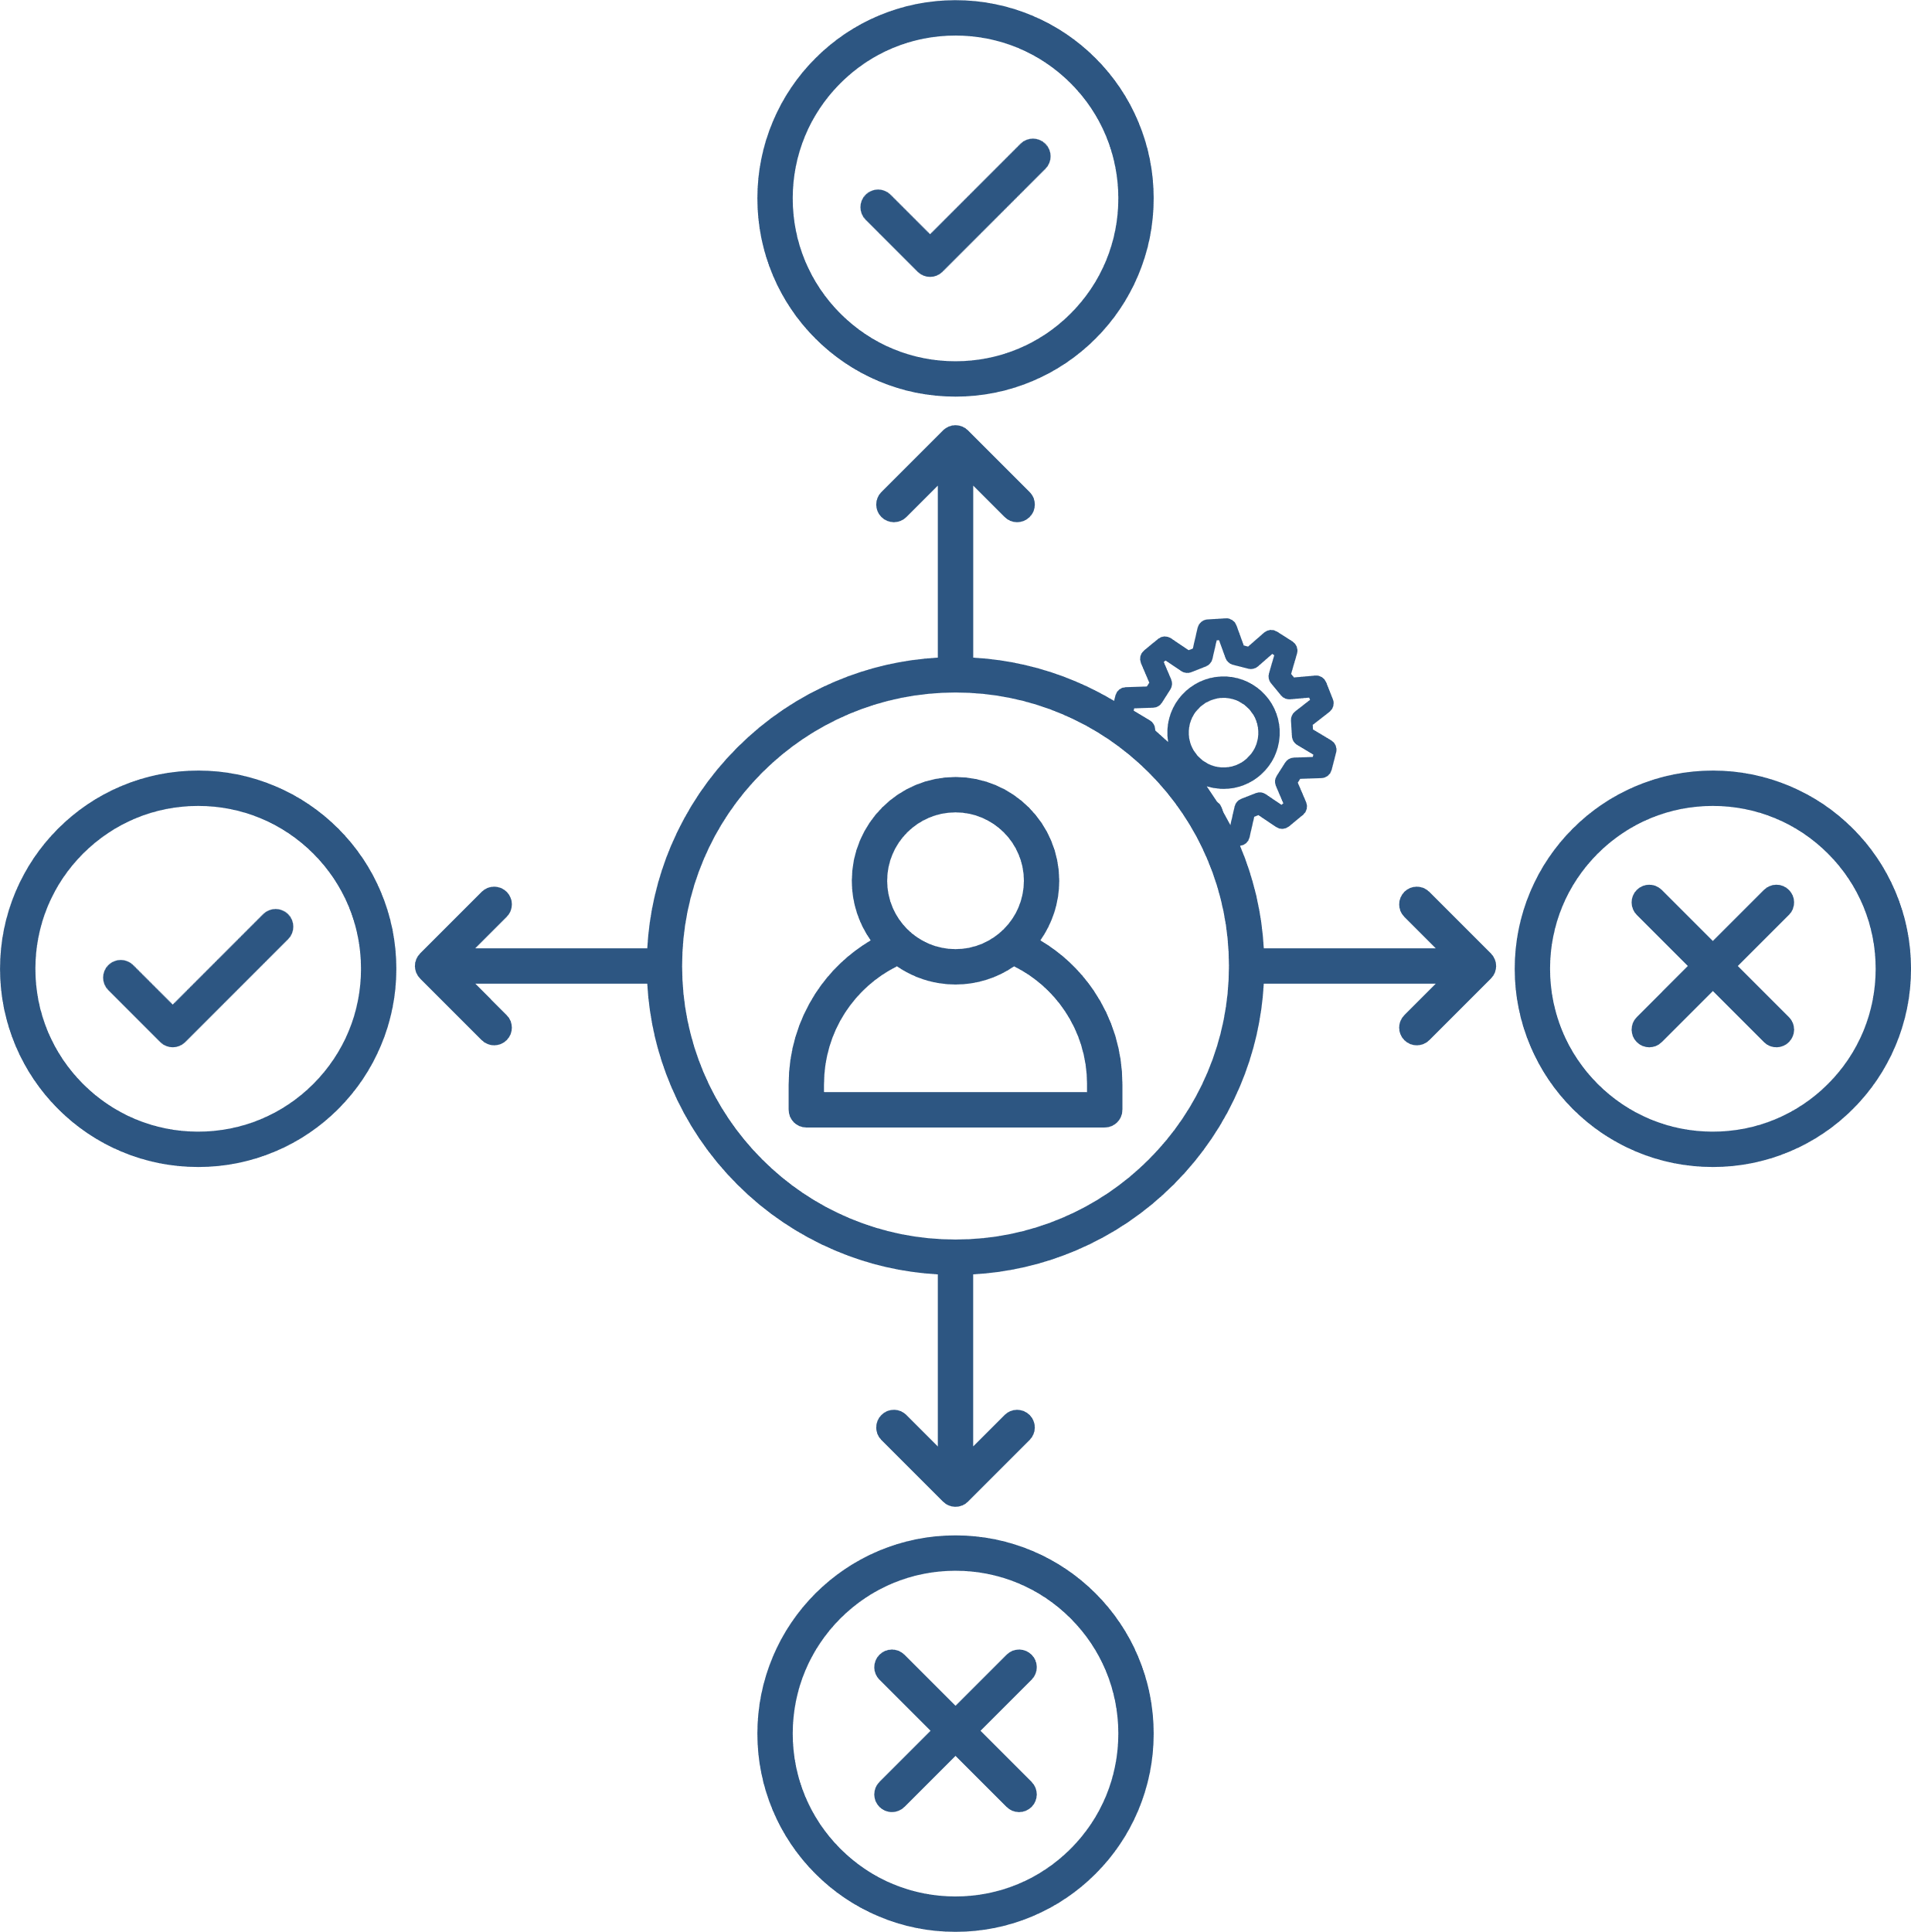
AIMS
Overall Aim
To foster positive engagement with healthcare services and residents.
Engagement with Health and Social Care Services
The first objective of the pilot was to ensure that individuals with ME/CFS and Long Covid can access reliable, specialist assessment, care, and management, regardless of their geographical location.
Adopting NICE Guidelines
‘Our plan was to review the current state of ME/CFS and Long Covid services, assess gaps in service provision, and provide recommendations for improvement.’
The second objective was to encourage and support NHS services, Integrated Care Boards (ICBs), and associated support services to adopt and implement the NICE guidelines for ME/CFS (NG206).
Addressing Individual Patient Concerns
The third objective was to engage with individuals and healthcare professionals (HCPs) to address and resolve individual patient concerns, ensuring that every voice is heard and issues are resolved both within and beyond the pilot region.

Slide 5










Key Findings
01
07
02
03
05
06
04
The fact that 68% of respondents in the working group rated their overall NHS ME/CFS care as 'poor' or 'very poor' highlights the urgent need for service quality improvement.
Coding for ME/CFS is often not done correctly, and many patients are not recorded as having ME/CFS, making it difficult to maintain accurate statistics.
On average, individuals wait 6 months to see a specialist after visiting their GP, with 30% waiting over 12 months.
Inappropriate exercise-based and psychogenic treatment models continue to persist in some areas of the Integrated Care Board (ICB).
There are significant inconsistencies in diagnosis, treatment pathways, and professional understanding, which undermine trust in ME/CFS care.
Only 4% of people were satisfied with their treatment plan from specialist services. 48% were very dissatisfied and 15 % dissatisfied.
Severely affected ME patients in the region lack adequate support.

Slide 6
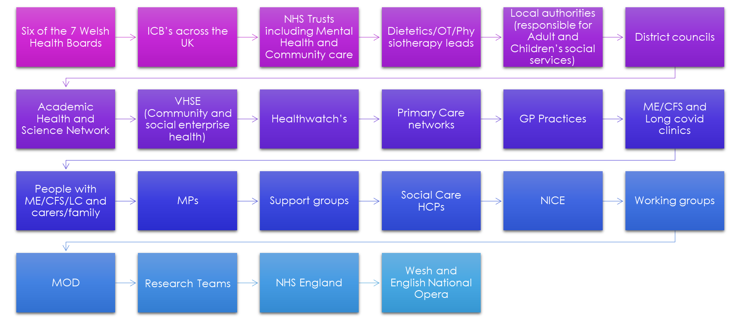
We worked with

Slide 7
Actions and Impact
Patients frequently reported that their symptoms were often dismissed or attributed to mental health causes. This led to disengagement from services and, in some cases, a loss of trust in the healthcare system.
Historic negative experiences with Graded Exercise Therapy (GET) were reported, including prolonged post-exertional malaise (PEM) and for one attendee, temporary paralysis.
We wanted ME/CFS services to be shaped by the very people who used them and we asked for patient and/or carer representatives to join together to form a working group.
Through a series of working group meetings, key areas of concern and opportunity were identified. This included the need for more coordinated services and the importance of specialist roles within a multi-disciplinary care team.
There was a strong emphasis on making services more inclusive, particularly for the most severely impacted patients.
Severely affected housebound patients remain unable to access:
Basic healthcare (blood tests, smear tests, dental care)
Appropriate mobility aids without significant advocacy
Social care, personal care support, and welfare benefits
None of the patients in the working group had received an annual review by their GP for ME/CFS.
Existing services often lack holistic, multi-disciplinary approaches including a specialist consultant or GP with special interest, physiotherapy, occupational therapy, speech and language therapy, dietetics, and specialist nursing.

Slide 8















Actions and Impact
A glimpse of the support from H4ME
A complaint was raised to the team following the recommendation of Graded Exercise Therapy at the Oxford University Hospitals Trust.
Essex Community ME/CFS Service excluded someone from their service due to her high BMI. H4ME carried out some research and conferred with Dr Shepherd.
Lincolnshire County Council provided outdated information recommending GET and referencing the PACE Trial.
We concluded there was no medical reason to refuse a patient with a high BMI and met with the service lead and consultant. They apologised and removed the BMI exclusion criteria from their website and referral form.
We requested that the County Council remove this information and update their website to comply with NICE Guidelines, and provided guidance to ensure an evidence-based understanding of ME/CFS.
Following a letter and calls from the team with the patient's consultant, Oxford University Hospitals have removed GET from their treatment plan and from the website and leaflets.

Slide 9
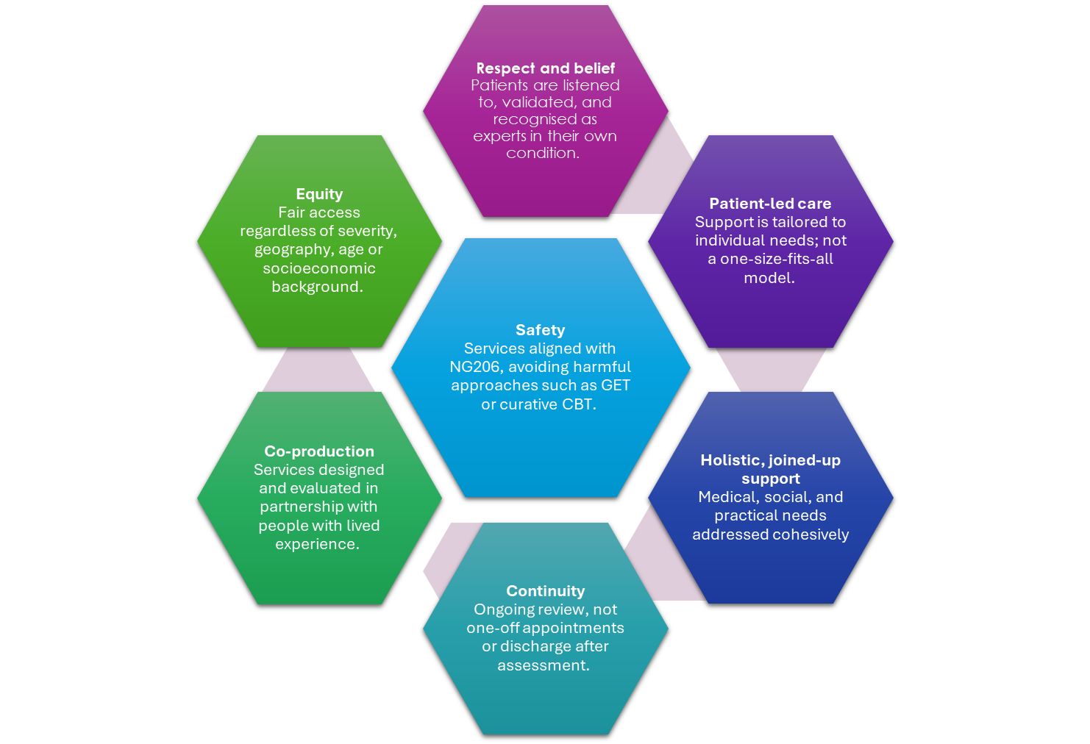
WORKING GROUP
An analysis of working group member views on an ideal patient pathway highlighted 7 areas that should underpin service design and delivery.
Lived experience feedback
The working group recommended establishing a specialist hub to provide ongoing follow-up care and annual reviews in line with NICE guidance.

Slide 10
WORKING GROUP
Lived experience feedback
Early diagnosis and first-line support
Medically led multidisciplinary team
The group favours a structured, holistic ME/CFS and LC Hub model offering the following
Social and practical support
Management approach
Learning and research
Continuity of care

Slide 11
WORKING GROUP: DEMOGRAPHICS
DEMOGRAPHICS
87% patients | 13% carers
80% female | 20% male
93% White | 7% Mixed / Multiple Ethnic Group
Many members of the working group were housebound due to the severity of their ME/CFS/LC, between moderate and severe. They also described similar experiences of dismissal of their symptoms by healthcare professionals and a lack of NHS support, which resulted in some members disengaging with NHS services
AGE RANGE
SEVERITY
18 - 25 = 21%
26 - 35 = 0%
36 - 45 = 14%
46 - 55 = 43%
56 - 65 = 21%
66 + = 0%
7% mild
60% moderate
33% severe/very severe

Slide 12





Feedback from the ME/CFS/LC community
Reviews taken at random from NHS review of specialist services portal on MEA website
Poor service, not meeting NICE guidelines,
no Consultant. Physio nearly killed me,
they had no idea what ME was, stating ME
was chronic fatigue & was not recognised
by WHO as a neurological condition”
Got the worst advice I've ever had from their "specialist GP" who told me to throw away my
heart rate monitor and exercise! Led to a further serious crash that I have never recovered
from.
This service left me very disappointed. They told me that as I have severe ME/CFS they could
not offer me any help. How can it be that the more severe your illness is, the less help is
available?
Was diagnosed January 2020 (pre-lockdown) from one phone call. Never met a single
person. Care wasn’t specialised at all. Very generic. I felt like another number
Admittedly diagnosed during covid, but never even spoke to consultant. Very good monthly
zoom appointments with OT for pacing.

Slide 13





Next Steps for Health and Social Care
We aim to build on the insights and experiences gathered during the pilot program, applying these lessons to enhance our strategies and expand our outreach, ultimately reaching a larger population and increasing awareness of our mission.
To support our efforts, we will initiate or strengthen educational training programs for healthcare providers, ensuring they possess the most relevant knowledge and skills.
Impact
Education
  Support the delivery plan and promote equitable care nationwide.
  Share successful service models for other specialist services to adopt (with permission)
  50% of staff at GPs complete ME/CFS training.
  1 person at each surgery for specialised training and to liaise with H4ME
Raise awareness
Ongoing care via GP services
  Engage and encourage participation in development.
  Increase activities, proactively reaching out to all services
  Continuous service from hospital to home.
  Once patient discharged from specialist services care returns to GP who will manage their health and schedule annual ‘checkups’

Slide 14
And finally
We look forward to continuing to work with BOB ICB to ensure that the findings of our BOB ICB pilot report are actioned and that the views obtained through our patient engagement work are incorporated into future service development.
We extend our sincere thanks to all participants in our pilot project. Your contributions and support have been invaluable, and the comprehensive information collected from both professionals and the public reflects them.
The Healthcare team.
Healthcare 4 ME
Email: health@meassociation.org.uk

